Slide 1
Gym Tracker Mobile Application
Student Name: Oskar Grzenda
Supervisor Name: Joe Corr

Slide 2
Context & Objectives
Context
A mobile application that will allow users to track their gym progress in an easy and visual way
Key Objectives
Enhance my mobile app development skills
Learn more about React-Native
Showcase at interviews
Use React-Native to develop my mobile application

Slide 3
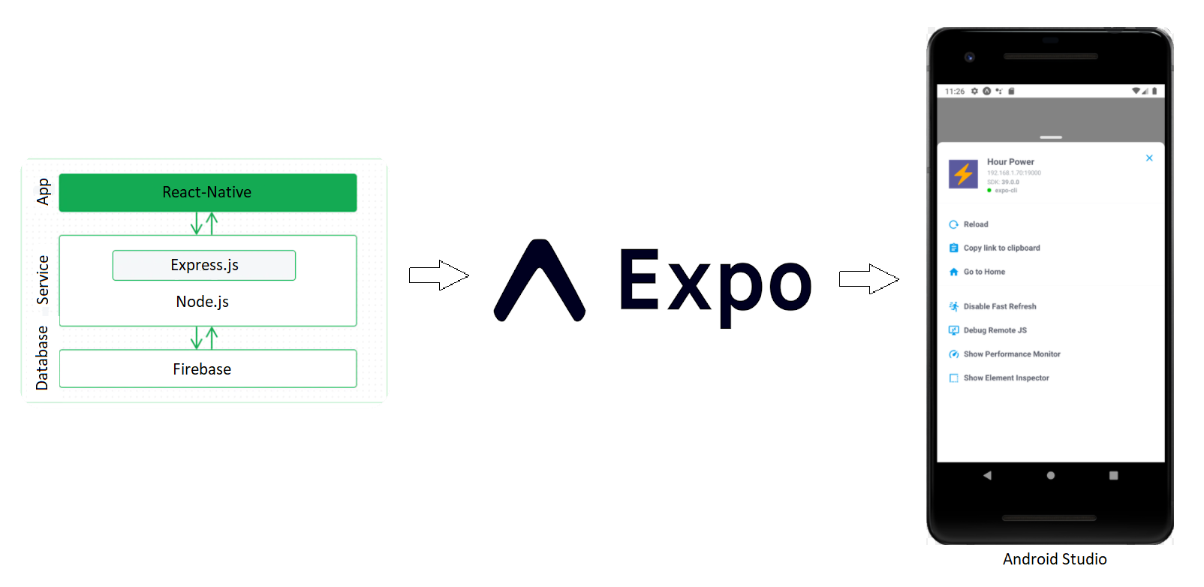
Technologies & System Architecture
React-Native
React-Native: Front-end JS library for UI components
Node JS: back-end JS run time environment which runs JS codes
Express JS: Framework for Node.js
Firebase: Backend database
Expo: Command line app that allows to run your code in a mobile emulator, connects the react-native code and displays the app on the android studio emulator
Android Studio: This is used to create a mobile emulator and display a functional mobile application

Slide 4
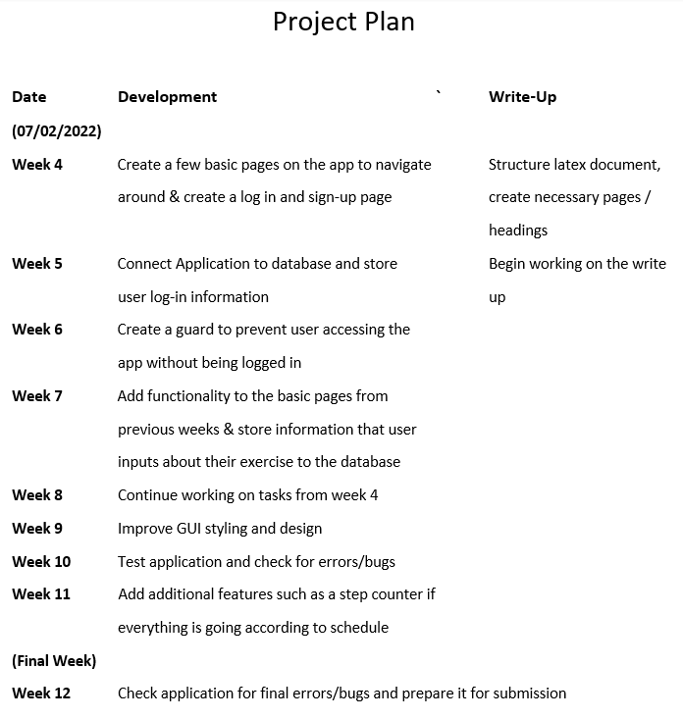
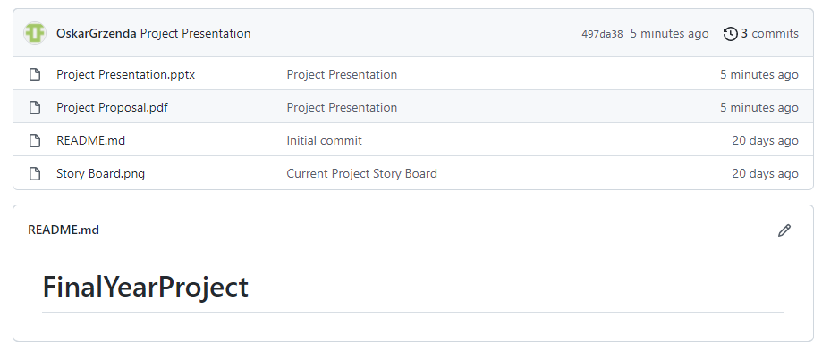
Development
GitHub repository
Project Dissertation
Project Planner
Word document with weekly tasks
Weekly Meetings

Slide 5
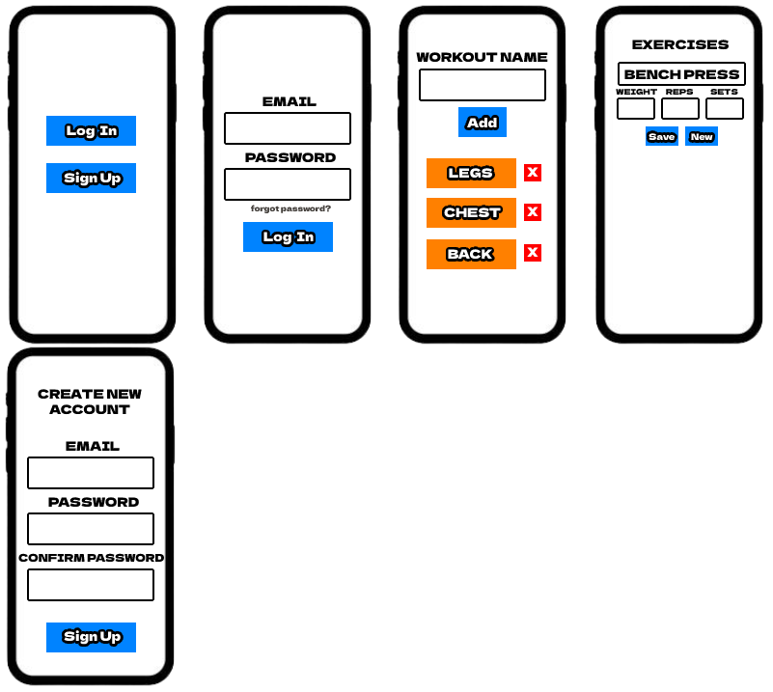
Project Design
Project Wireframe

